Slide 1

Distributing Quality of Service (QoS) Policies in
Name-based Networks
Autonomous Network Management Systems 2025 co-located at ICDCS 2025
Ryo Yanagida¹, Jeremy Singer¹, Paul Harvey¹, Leon Wong², and Colin Perkins¹
[1] University of Glasgow
[2] Rakuten Mobile, Inc.

Slide 2
Context
CDNs provide pull-based data delivery and are ubiquitous
Name-based networking moves CDNs pull-based model down the stack
  Part of the fundamental networking core infrastructure
  Providing pervasive caching natively
How to apply QoS to name-based networks?

Slide 3



Background — Current Internet
Current Internet sets up individual flows between the two hosts
Clients independently asks for the data and they receive the requested data separately

Slide 4

Background — Name-based Networking
Name-based networking, instead, routes interest towards where the data is
The data follows the path the Interest packet took
Interest: Jupiter.jpg
Interest:
Jupiter.jpg
Interest: Jupiter.jpg
Interest: Jupiter.jpg

Slide 5
Background — Name-based Networking
Routing over names:
  Brings key information about the data
  Requests can be aggregated and Data can be cached on-path
  Lightweight Mobility support (the data delivery traces Interest packet path)
  No IP address management
Consumers use names to request data from Producer
Forwarder forwards interest packets using name-prefixes
Names: structured/hierarchical approach seems to make sense:
  We see this in URL paths today
  <domain>/<URI-esque path>/<segmenting>
  netflix/live/football/2024-04-12-ManU_vs_City.mp4/24
  Prefix: netflix/live/*
No standard QoS mechanism for Name-based Networking protocols

Slide 6
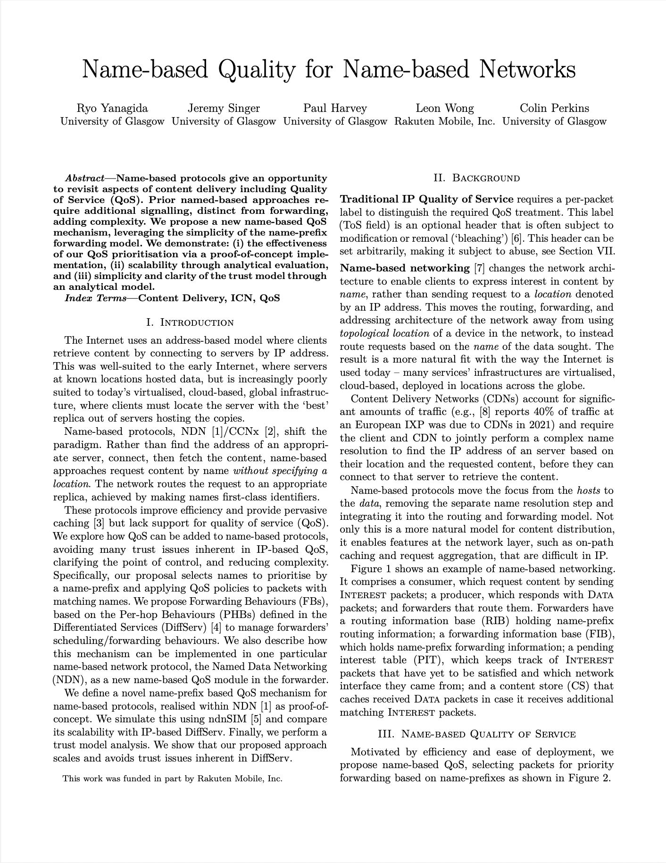
Name-based Quality for Name-based Networks
Ryo Yanagida, Jeremy Singer, Paul Harvey, Leon Wong, and Colin Perkins
To be presented on Tuesday, Industry 1 session
Key points:
Purely name-prefix approach to enabling QoS mechanism for Name-based networks
Name-prefix are fundamental, and exposes the semantics of the data being transmitted
Allows a selection of a set of data to be given QoS treatment
ns-3 based simulation shows promising results
Simplifies trust model, removing uncertainties
This needs to be configured on forwarders across a network
How do we distribute these policies?

Slide 7
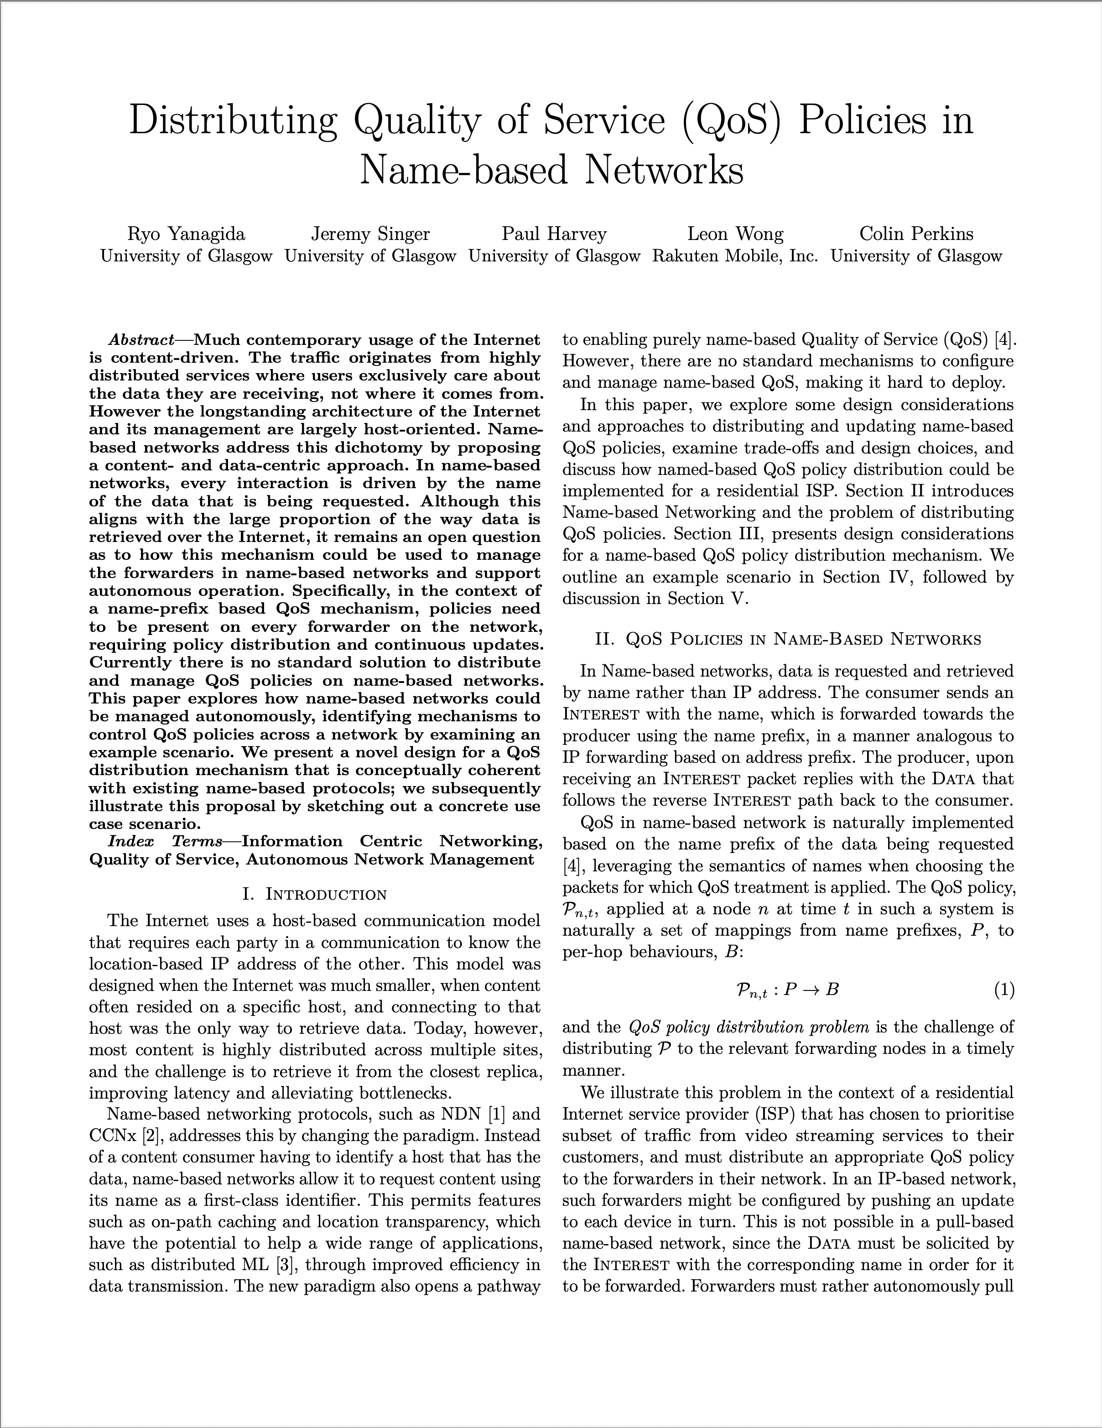
Distributing Quality of Service (QoS) Policies in
Name-based Networks
Ryo Yanagida, Jeremy Singer, Paul Harvey, Leon Wong, and Colin Perkins
Name-based QoS does not have explicit ‘marking’ on the packets
  Forwarders match the name-prefix to the corresponding policy
  Forwarders needs to know the mapping
Network operators needs to distribute the prefix-policy mapping
How do we do this in name-based networking fashion?
  Naming structure
  Frequency/timing requirements
  Appropriate mode of policy retrieval

Slide 8
Design Consideration
Naming
  There are many names to consider!
    Content name (and its prefix)
    QoS Policy name
    A Forwarder or a group of Forwarders
    Version of the policy
  Name-based networking uses structured names; how to structure them is important
Timing of Policy Updates
  Some policy is known in advance, some are much more spontaneous, timing requirement of distribution changes
  Some policy needs to be not only distributed but applied quickly, others, not so much
Triggering QoS Policy Distribution
  Name-based approach requires the Interest for the Data containing the policy (-set) can be sent out
  Time sensitive use-case might require RPC mechanisms

Slide 9
Design Consideration
Policy Name
Affects trigger method
Forwarder or a group
Policy Version
Timing
Names
Scheduled
On-Demand
Traffic Management
Alias
Content Name (prefix)
Affects granularity, grouping of policies
Timer
Different overheads
Affects Naming/Alias
Trigger
Name-based RPC
Policy Entry
Policy Set
Policy Format
Traffic
Policy Index
Policy Set Index
Notes:
We explored a range of design consideration for QoS Policy Distribution
First, we looked at naming; since the protocol itself is Name-based, there are many ‘names’ to consider.
Name of the content, and its prefix
Name of the forwarder or a group of forwarder
Naming of policy
Version of policy
The way we structure them affects how granular we can configure policy. Because the policy is fetched by name, this affects how the forwarder can fetch policies in bulk
We also looked at timing requirements of policy updates.
We considered types of update; scheduled, on-demand — traffic triggered policy change, and traffic management — network operator triggered policy change.
We also looked at it in terms of distribution and application; when to fetch the policy and when to apply the policy.
These depends on the use-case and informs update trigger mechanism choice.
Scheduled is fairly self-explanatory, for On-Demand, perhaps we can pre-distribute, but activate once the user triggers a priority, like pay-per-view service might get a priority.
If the application of the policy must be immediate, the distribution probably needs to be immediate too.
One of the challenges of Name-based approach is that the host receiving the data must initiate communication — i.e. no mechanism to push the data but rather, a mechanism to trigger data fetch.
We also considered how these policy update should be formatted or structured. This affects the way policy names are done including how they are structured.

Slide 10
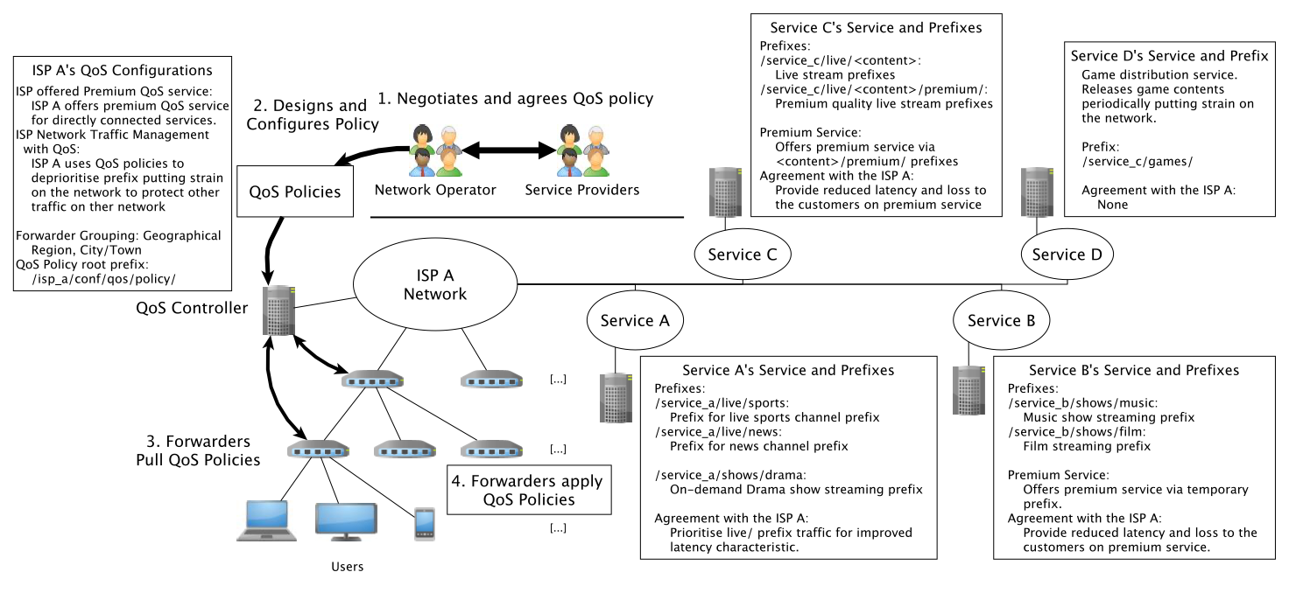
Example
Notes:
We then came up with a potential scenario, covering different use-cases/situations where we might utilise QoS policy distribution mechanism;
Service A — Simple case with one single prefix to prioritise, just the live/ prefix.
Service B — A bit more complex with temporary prefix; either bloat the policy store in advance, and trigger, or set forwarders to fetch them as traffic passes through, just for service_b traffic
Service C — Since each content prefix comes with separate /premium/ name component, bloats policies, requiring individual <content_name>/premium entries,
Service D — No agreement but since it distributes games, might prompt ISP to tame their traffic

Slide 11
Discussion
Naming is a core aspect to consider in designing/implementing QoS policy distribution (and any other policies that each forwarder needs!)
Timing requirements heavily depends on the use-case, and requires the understanding of trade-offs. This also applies to any other configuration/policies the forwarder needs to retrieve.
In the data/content distribution context, name-based approach can fit the use-case well and be very efficient. However the decoupling of end-hosts makes configuration/policy distribution challenging, especially with different timing requirements

Slide 12




Key Takeaways:
We identified key areas of consideration in distributing QoS policies in Name-based networks
  Naming
  Timing requirements (delivery and application)
  Update Triggering mechanism
  Grouping of Policies
Presented example scenario outlining different approaches
While we looked at name-based QoS, the similar challenge applies to a range of other configuration
Ryo Yanagida¹, Jeremy Singer¹, Paul Harvey¹, Leon Wong², and Colin Perkins¹
[1] University of Glasgow
[2] Rakuten Mobile, Inc.
#UofGWorldChangers
@UofGlasgow

